Slide 1
Lecture 16: Game Theory
Further game theory examples
Optimizing a unique number game strategy
Use of a Nash equilibrium as a practical tool
Generation of random numbers following an arbitrary distribution
Timing routines in Python

Slide 2
The AM50 competition!
We are going to play many repeated unique games in AM50
There will be a hundred sets of ten million rounds, making 1,000,000,000 rounds in total
Homework exercise 1: write a Python function to implement a strategy for these repeated game
Different considerations to the game in class
Playing a pure strategy may be problematic; a mixed strategy may be advantageous

Slide 3
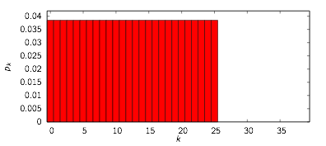
From the lab: uniform random up to some value
from random import randint
def play(n,hist,lw,lc,y):
return randint(0,25)
Chooses numbers over a reasonable range
However, it can easily be beaten
Key problem: does it really make sense to choose 25 with the same probability as 0? Winning with 25 requires many other things to work out

Slide 4
A simple weighted random strategy
Question: distribution will the following function give?
from random import randint
m=2
def play(n,hist,lw,lc,y):
return randint(0,randint(0,m))
Can rewrite as
from random import randint
m=2
def play(n,hist,lw,lc,y):
j=randint(0,m)
return randint(0,j)

Slide 5


Probabilities
j will take the values 0, 1, and 2 with one third probability each
Table of outcomes
Hence

Slide 6
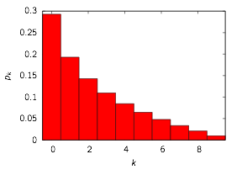
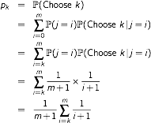
Calculating the probabilities
For arbitrary m, the probability of choosing k is given by
Probabilities for m = 9

Slide 7
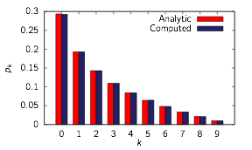

Random sampling
Input program
Output
from random import randint
# Test function returning weighted
# random number
m=9
def play():
return randint(0,randint(0,m))
# Bins to store
b=[0 for i in range(m+1)]
# Carry out a large number of trials
# and bin the results
trials=1000000
for i in range(trials):
b[play()]+=1
# Output the estimated probabilities
for i in range(m+1):
print "%d %g" % (i,float(b[i])/trials)
10⁶ trials
10³ trials
Examples: r_sample.py and r_analytic.py

Slide 8
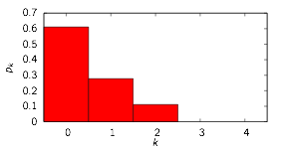
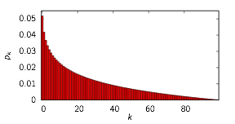
Finding an optimal value of m
For 70 players, what would be a good value of m to use? Both extremes don’t look very attractive:
Borrow an idea from Nash: find a value of m where if all players use that, then there is no advantage for one player to switch to a different m
m = 2
m = 99
0,1,2 likely to be eliminated in 70-person game
High numbers played too often; 80 is unlikely to ever win

Slide 9
Optimization results for 70 players
Suppose that the last player tries a slightly different value, m’
Define an efficiency as
Search for a value m where last player cannot gain advantage: E lower in for both higher and lower m’
m | E for m’=m – 10 | E for m’=m + 10
0 |  | ∞
10 | 0.000 | 4.828
20 | 0.368 | 1.143
30 | 0.964 | 0.934
40 | 1.082 | 0.907
50 | 1.096 | 0.914
60 | 1.119 | 0.939
70 | 1.092 | 0.918
80 | 1.084 | 0.915
90 | 1.093
(10⁶ trials for each test)

Slide 10
A more refined search
Once we are in the right ballpark, we can progressively refine the search by using more trials
m | E for m – 2 | E for m + 2
22 | 0.959 | 1.028
24 | 0.986 | 1.024
26 | 0.990 | 1.004
28 | 0.998 | 0.996
30 | 1.006 | 0.987
32 | 1.006 | 0.995
34 | 1.012 | 0.987
36 | 1.016 | 0.982
38 | 1.018 | 0.981
m | E for m – 1 | E for m + 1
25 | 0.9934 | 1.0049
26 | 0.9968 | 1.0019
27 | 0.9981 | 1.0008
28 | 0.9994 | 0.9987
29 | 1.0014 | 0.9970
30 | 1.0038 | 0.9966
31 | 1.0043 | 0.9951
Four million trials for each test
One hundred million trials for each test

Slide 11
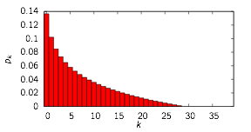
Optimality of this solution
If players were limited to choosing these strategies, then a value of m = 28 would be a Nash equilibrium: no player can gain advantage by altering his/her value of m
Choosing values up to 28 seems fairly reasonable
It also beats the strategy of always playing zero
However some strategies can still win against it

Slide 12

Picking from an arbitrary distribution
Suppose we have probabilities pk and we wish to choose number k with probability pk
Example with five probabilities
Define cumulative probabilities
Probabilities on a number line:
0
c0
c1
c2
c3
c4 = 1
p0
p1
p2
p3
p4

Slide 13
First approach
0
c0
c1
c2
c3
c4 = 1
p0
p1
p2
p3
p4
U
Choose random number U uniformly distributed from 0 to 1 (using Python “random” function)
Find which interval U lies in, and choose the corresponding number
Simple algorithm: if U < c0 choose 0, otherwise if U < c1 choose 1, otherwise if U < c2 choose 2, etc.

Slide 14


Example: geometric distribution
Recall from homework 4, X follows a geometric distribution if
Can create a truncated geometric distribution with n outcomes,

Slide 15
Random sampling
Input program
Output
from random import random
# Total number of entries to consider
n=100
# Create a truncated geometric distribution
l=0.95
p=[0]*n
p[0]=(1-l)/(1-l**n)
for i in range(1,n):
p[i]=p[i-1]*l
# Create cumulative probabilities
c=[0]*n
c[0]=p[0]
for i in range(1,n-1):
c[i]=c[i-1]+p[i]
c[n-1]=1.0
# Function to calculate a random variable
# following the distribution of the p[k]
def geo1():
r=random()
k=0
while(r>c[k]):
k+=1
return k
# Print some random numbers
for i in range(20):
print geo1()
1
22
0
16
6
52
32
9
18
3
2
13
2
9
25
2
42
6
12
81
Example: cumul.py

Slide 16
Improved approach (bisection)
0
c0
c1
c2
c3
c4 = 1
p0
p1
p2
p3
p4
U
lo
test
hi
First check if U is smaller than c0
Otherwise it is between c0 and c4: set those limits to be lo and hi
Set test to halfway between at c2
If test > U, set hi to test. If test < U, set lo to test
Repeat until lo and hi are adjacent

Slide 17
Improved approach (bisection)
0
c0
c1
c2
c3
c4 = 1
p0
p1
p2
p3
p4
U
lo
test
hi
First check if U is smaller than c0
Otherwise it is between c0 and c4: set those limits to be lo and hi
Set test to halfway between at c2
If test > U, set hi to test. If test < U, set lo to test
Repeat until lo and hi are adjacent

Slide 18
Improved approach (bisection)
0
c0
c1
c2
c3
c4 = 1
p0
p1
p2
p3
p4
U
lo
hi
U is between c2 and c3, so return 2
First check if U is smaller than c0
Otherwise it is between c0 and c4: set those limits to be lo and hi
Set test to halfway between at c2
If test > U, set hi to test. If test < U, set lo to test
Repeat until lo and hi are adjacent
Notes:
For n values, the number of steps needed by this algorithm is proportional to log n, since at each step the search interval is halved.

Slide 19
Python example (explicit)
Input program
Output
# Handwritten bisection routine
def geo2():
r=random()
lo=0
hi=n-1
# Check for boundary case
if(c[lo]>=r): return 0
# Carry out the bisection
d=hi-lo
while(d>1):
e=lo+(d>>1)
if(c[e]<r): lo=e
else: hi=e
d=hi-lo
return hi
# Print some random numbers
for i in range(20):
print geo2()
2
52
2
5
86
0
8
36
34
11
9
12
24
26
10
7
23
2
19
2
Example: cumul2.py

Slide 20
Python example (using routine)
Input program
Output
25
33
29
0
16
15
7
44
28
3
1
2
0
31
73
20
18
28
5
60
import bisect as bi
# Python's bisection routine
def geo3():
return bi.bisect(c,random())
# Print some random numbers
for i in range(20):
print geo3()
Example: cumul3.py

Slide 21
Timing of routines
Python has a time module with a number of functions that can be used to time functions
We’ll consider two:
clock: returns the “processor time” in seconds as a floating point number—this is the actual time the program has been running on the processor
time: returns the actual time, as the number of seconds since a fixed date
Exact behavior can depend on the operating system
https://docs.python.org/2/library/time.html

Slide 22
A simple timed function
Input program
Output
from time import clock
# Count from 1 to 3
for i in range(1,4):
# Print the current number
print i,"..."
# Find the current time
t0=clock()
# Keep looping until the time
# advances by one second
while(clock()<t0+1):
pass
# Finish
print "Go!"
1 ...
2 ...
3 ...
Go!
Notes:
When this program is run, the output lines are printed out with a second delay between each.
Example: simple_timing.py

Slide 23
Timed output
Input program
Output
# Number of trials to do
trials=1000000
# Store the two timing routines
t0=clock()
t1=time()
# Carry out a large number trials
for i in range(trials):
x=geo1()
# Print the time per function call
print "clock routine : %.4f microseconds" \
% ((clock()-t0)*1e6/trials)
print "time routine : %.4f microseconds" \
% ((time()-t1)*1e6/trials)
clock routine : 2.6630 microseconds
time routine : 2.6654 microseconds
Example: timing.py

Slide 24
How do clock and time differ?
Most modern computers and laptops have dual-core or multi-core processors
Example output for the timing program on a dual-core machine:
Assuming no other programs are running, times are about equal:
clock routine : 2.6630 microseconds
time routine : 2.6654 microseconds
Notes: This sometimes referred to as “wall-clock time”, representing the passage of time in terms of a human observer watching a clock on the wall
time measure
Core 0
Idle
clock measure
Core 1
Idle
Actual time

Slide 25
Two jobs running simultaneously
If two run simultaneously, the two timing measures still agree
Each core handles one timing test each:
clock routine : 2.6529 microseconds
time routine : 2.6723 microseconds
clock routine : 2.6726 microseconds
time routine : 2.6942 microseconds
time measure
Core 0
Idle
clock measure
Core 1
Idle
Actual time
Second job running simultaneously

Slide 26
Three jobs running simultaneously
However, if three jobs are run, then there is a noticeable difference:
The computer will rapidly switch between the three jobs
The total elapsed time is about 3/2 of the actual time each job spends on the processor
clock routine : 2.6480 microseconds
time routine : 4.0000 microseconds
clock routine : 2.6853 microseconds
time routine : 4.0478 microseconds
clock routine : 2.7035 microseconds
time routine : 4.0826 microseconds
Notes: As this example illustrates, clock is better suited to timing tests, since it is not sensitive the total computer load.
time measure
Core 0
Idle
Core 1
Idle
Actual time
clock measure is sum of these

Slide 27
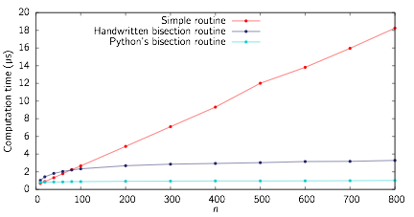
Timing
Notes:
The simple routine may be faster for very small values of n, but as n is increased the bisection routines always win due to their better scaling properties.

Slide 28
Some other things to consider in designing a unique number strategy
If you have a probability distribution in mind, the bisection routine can be used to rapidly create random samples from this distribution
Other things to consider:
Adaptivity: you know what other players did in previous rounds
Introspection: you know how well your previous strategies worked out

